Slide 1
SEMINÁRIO DE LÂMINAS DIGITAL
Patologia Mamária - caso 3
Thiago David Alves Pinto, MD, MSc
Diagnose / HBDF

Slide 2
Declaração de Conflito de Interesse
Dr(a). Thiago David Alves Pinto afirma não ter conflito
de interesse a declarar para a esta apresentação
Exigência da RDC Nº 96/08 da ANVISA

Slide 3
Mulher, 75 anos
HDA: Sangramento transvaginal.
RNM abdome - volumosa lesão expansiva em corpo uterino.
Carcinoma seroso de endométrio:
RH- / p53ab / pMMR / p16+;
pT1a (FIGO IA) / HER2 2+.
Comorbidades: obesidade, diabetes mellitus tipo II;
Antecedentes: tabagista - cessou em dez/2020;
Slide do autor

Slide 4
Mulher, 75 anos
TC tórax - Calcificações grosseiras na mama esquerda.
Mamografia - Nódulo Suspeito QIM Mama Direita;
Micros suspeitas Mama Esquerda. Bi-Rads 4
Mamotomia Mama Direita - CDIS / sólido e micropapilar / grau intermediário / RE 40% RP 20% HER2 1+ Ki67: 10%
Mamotomia Mama Esquerda - CDIS baixo grau nuclear / micropapilar e cribriforme / RE 90% RP 80% HER2: 2+ Ki67: 10%
Slide do autor

Slide 5
Mulher, 75 anos
Abril/21 Produto de setorectomia bilateral:
- Mama Direita: Carcinoma mamário 0,7 x 0,6cm, Grau 2, unifocal, margens livres,LNF não avaliados. pT1b.
- IHQ: RE 2% RP neg HER2 neg Ki67: 1%
Mama Esquerda: Ausência de neoplasia residual nessa amostra, HDU, papilomas intraductais, esclerose estromal
Slide do autor

Slide 6
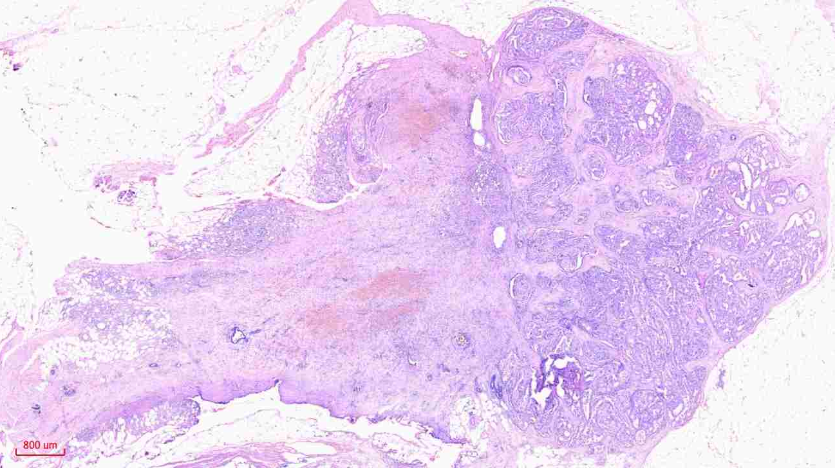
área acastanhada irregular medindo 1,6 x 1,6cm
H&E 10x
Slide do autor

Slide 7
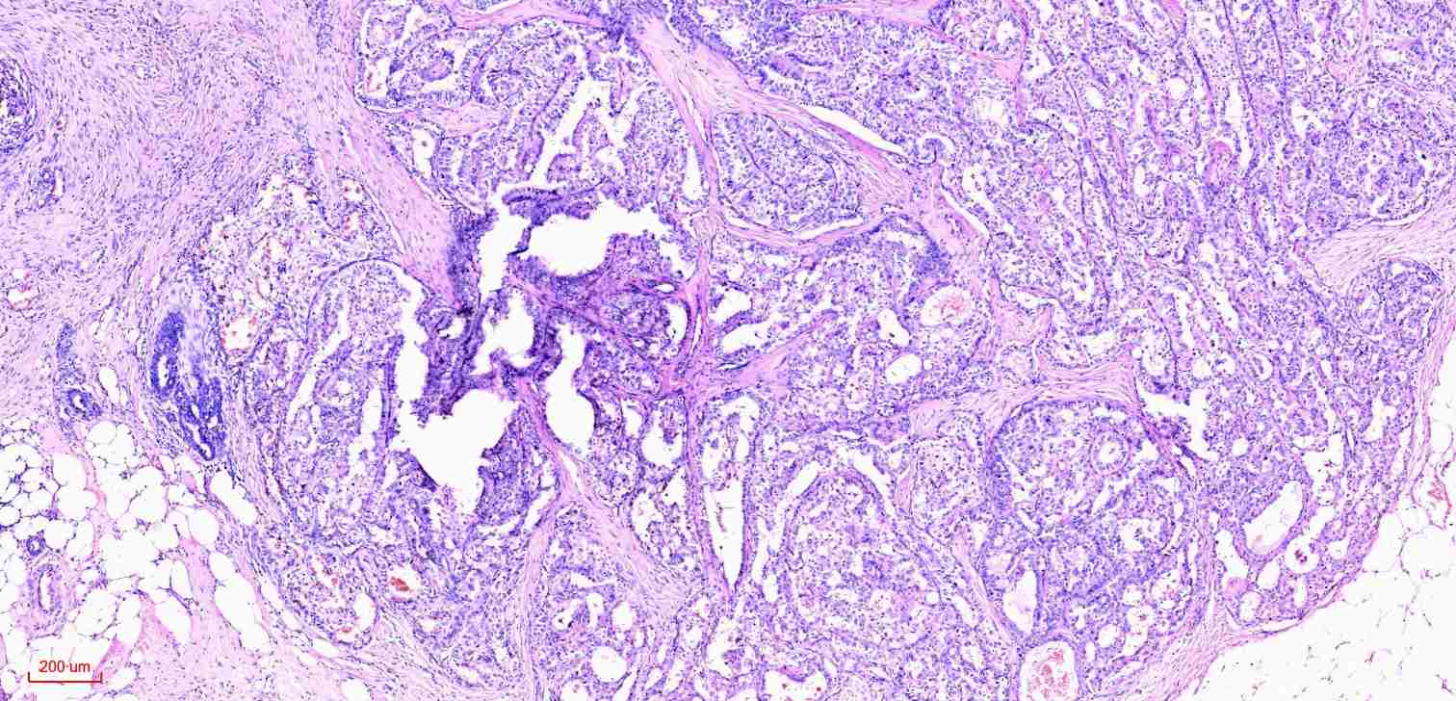
H&E - 40x
Slide do autor

Slide 8
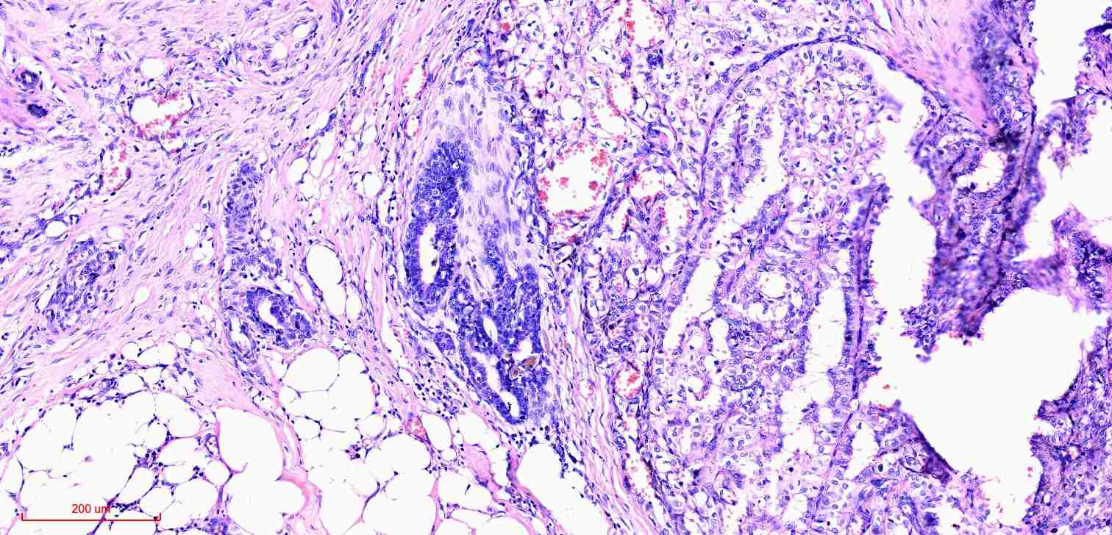
H&E - 100x
Slide do autor

Slide 9
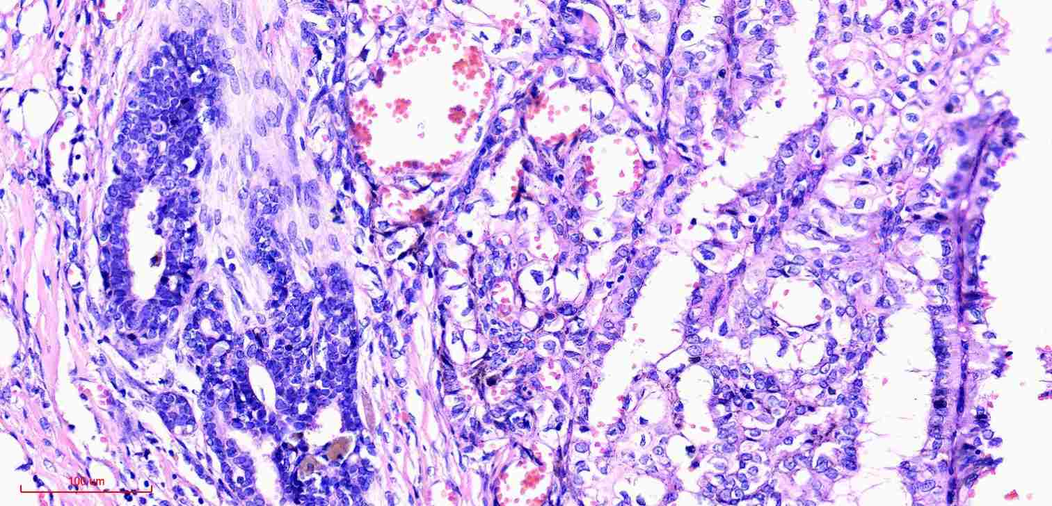
H&E - 200x
Slide do autor

Slide 10
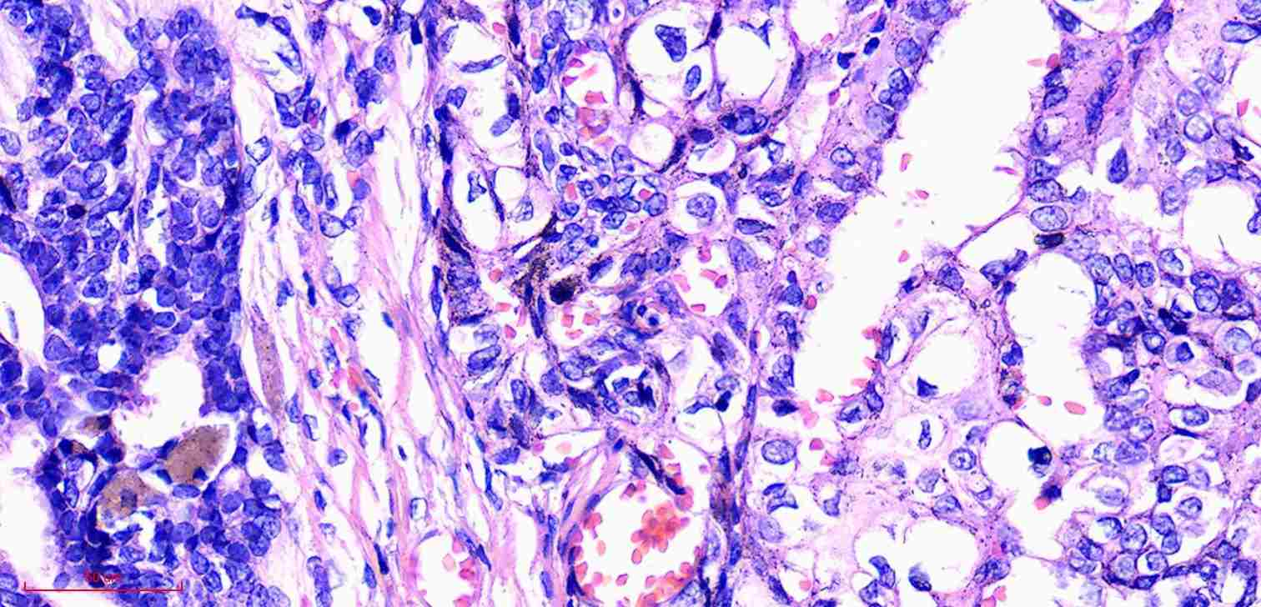
H&E - 400x
Slide do autor

Slide 11
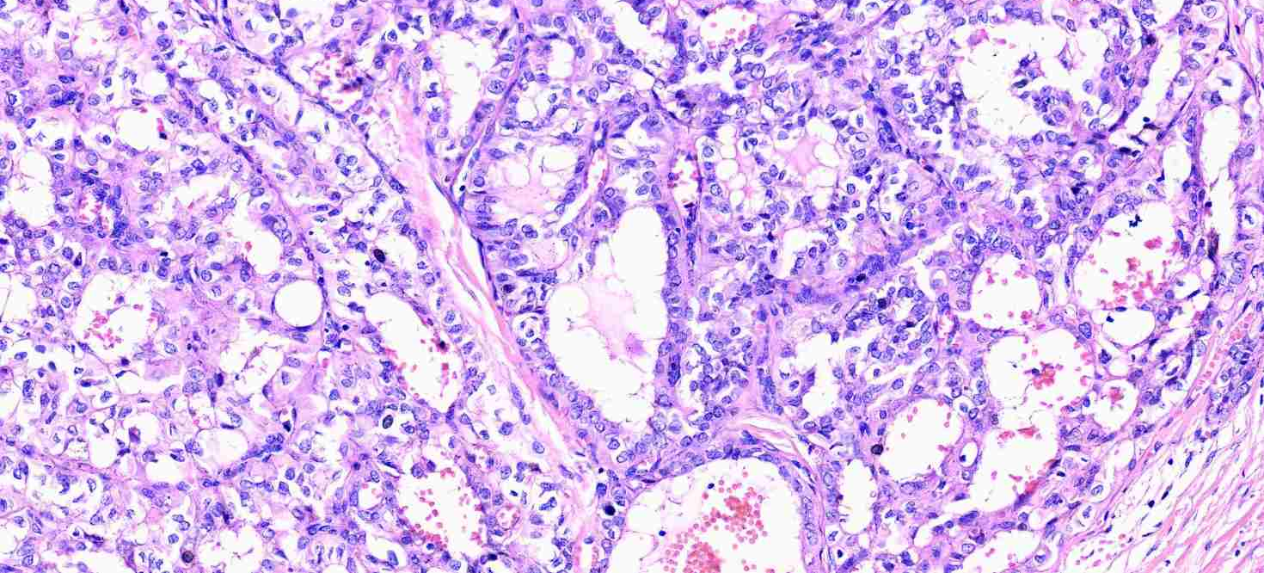
H&E - 200x
Slide do autor

Slide 12
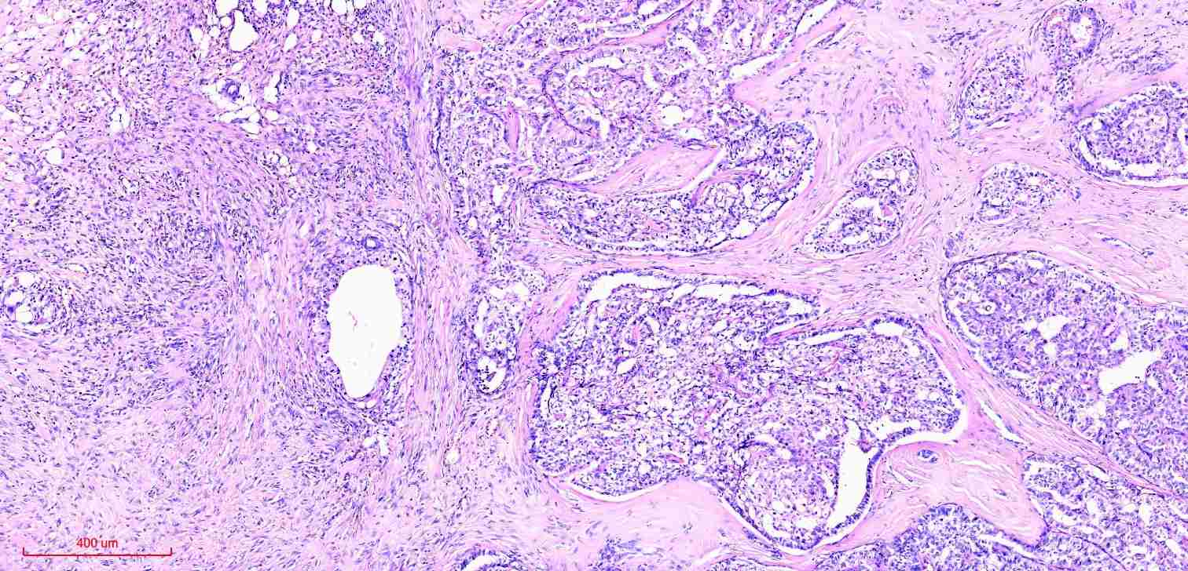
H&E - 40x

Slide 13
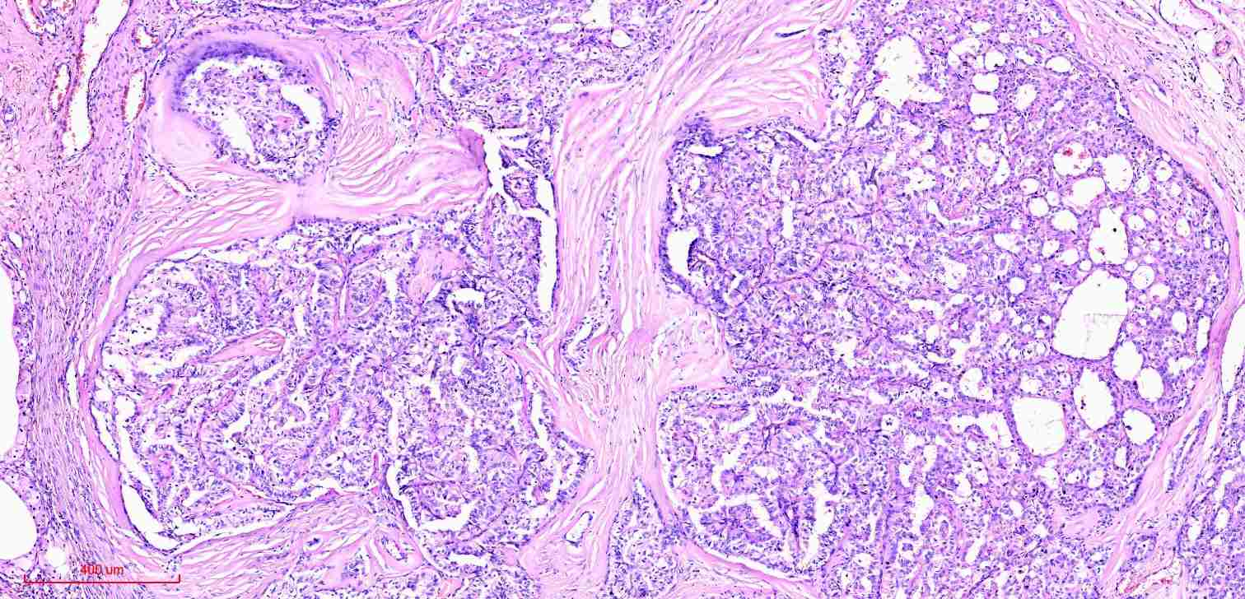
H&E - 100x
Slide do autor

Slide 14
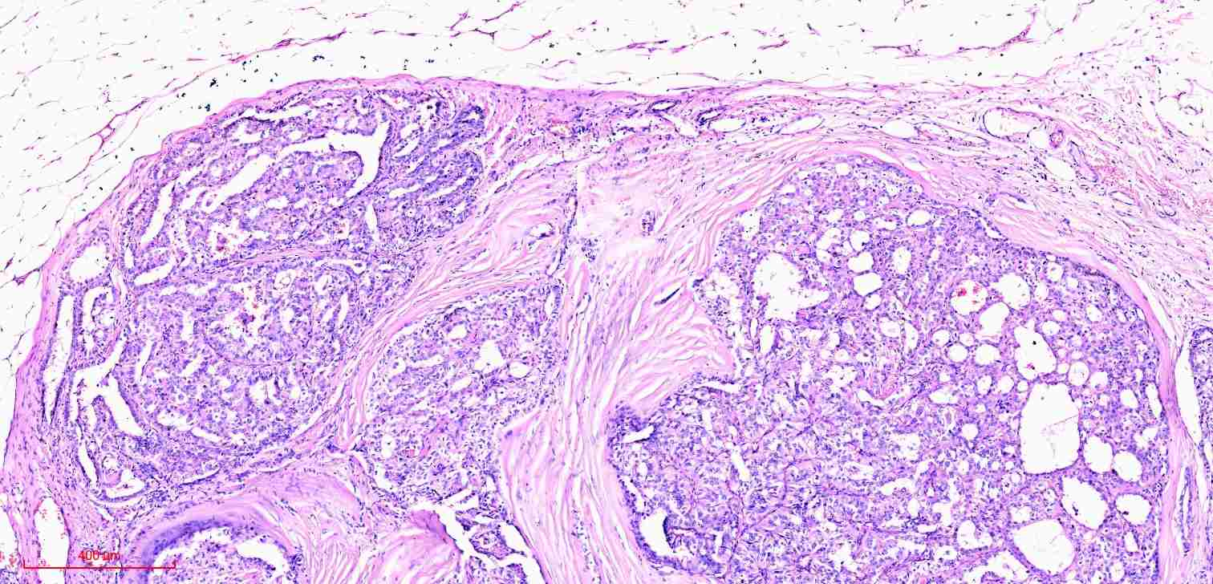
H&E - 100x
Slide do autor

Slide 15
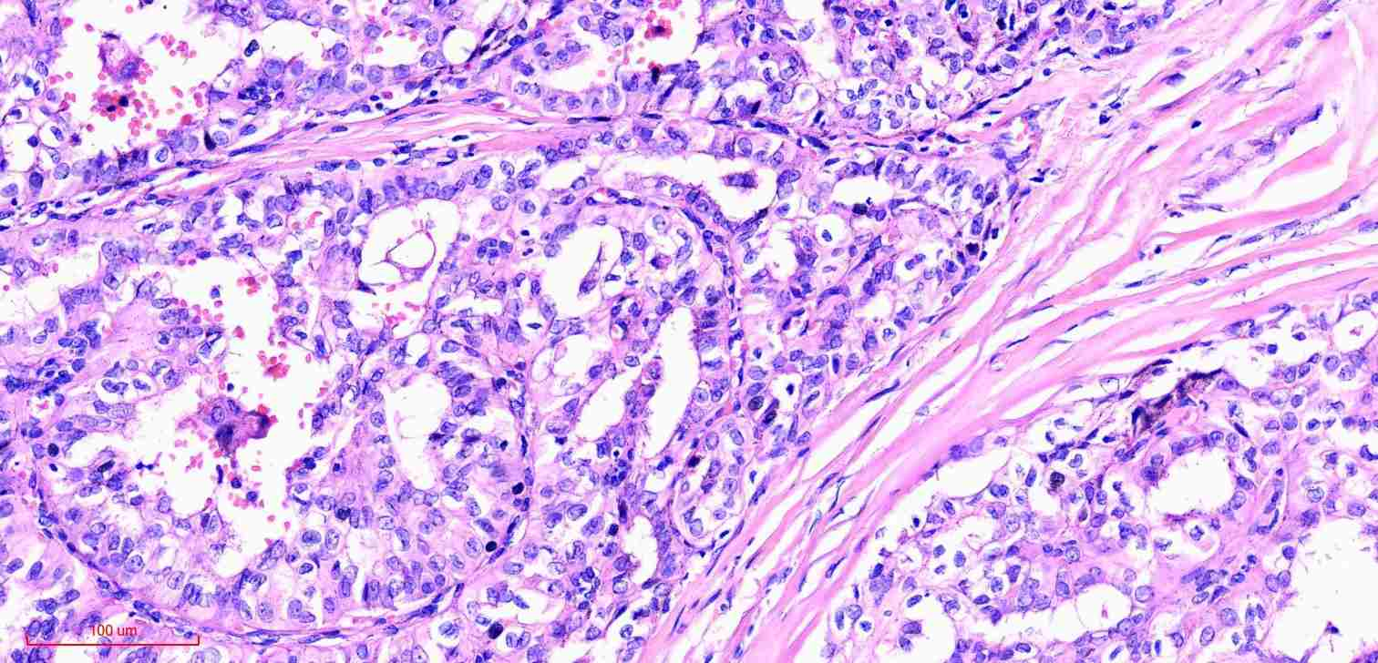
H&E - 200x
Slide do autor

Slide 16
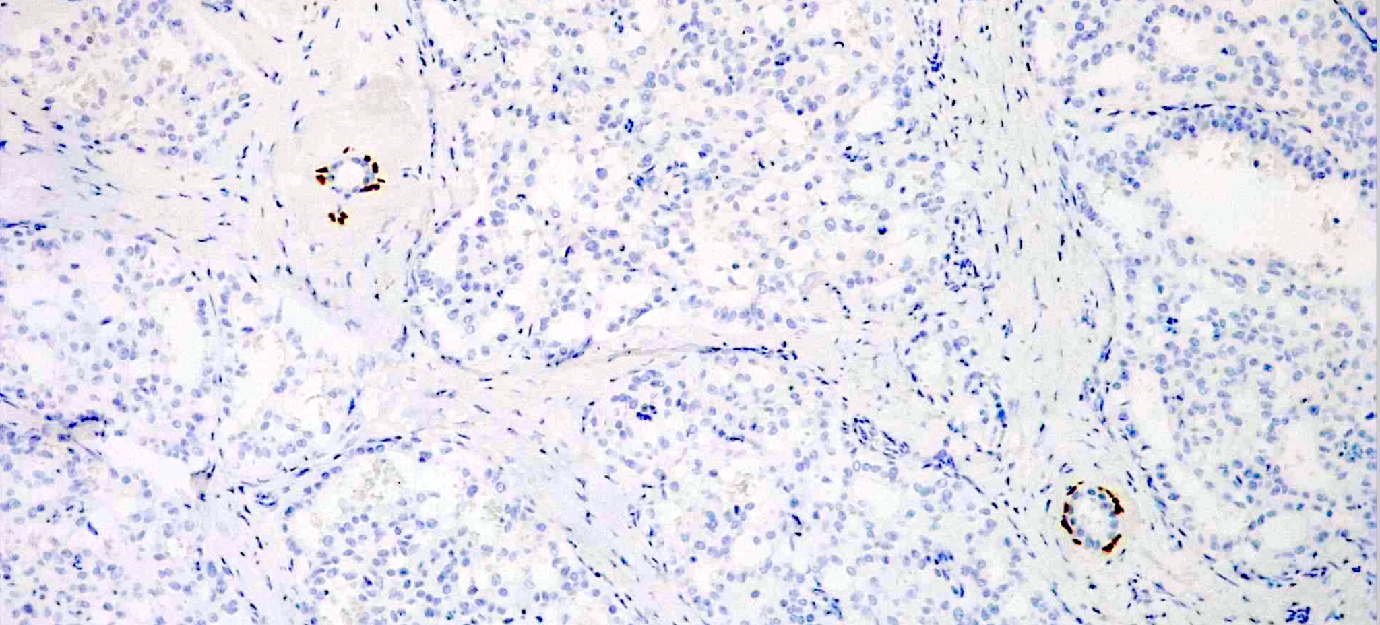
p63(DAK-p63)
Slide do autor

Slide 17
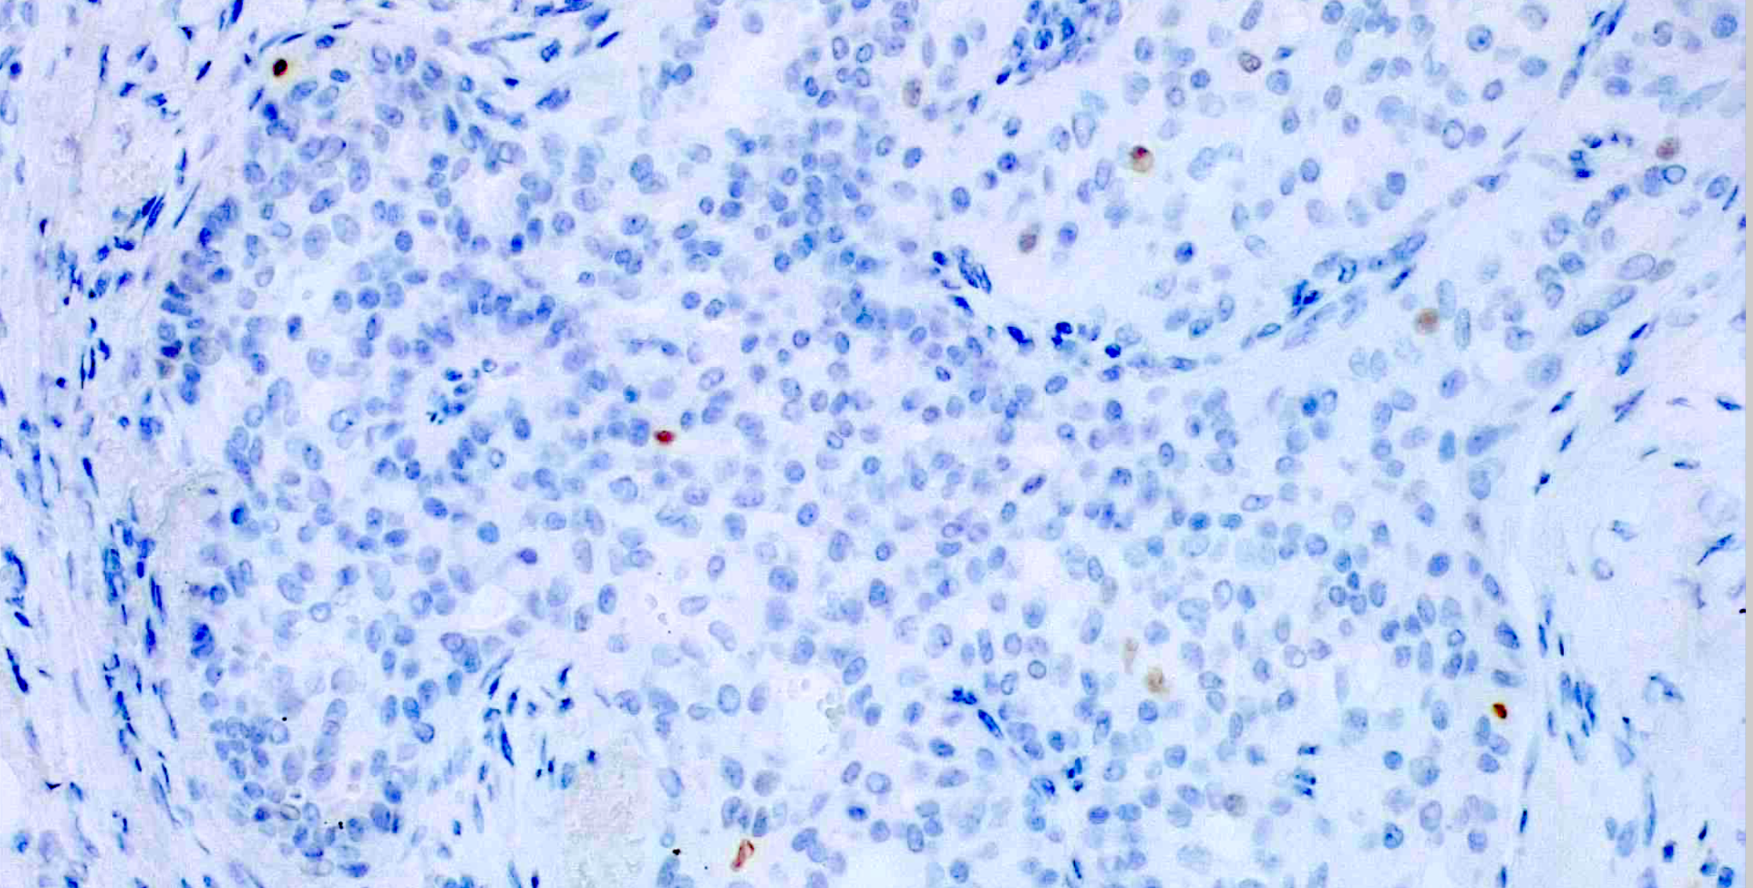
p63(DAK-p63)
Slide do autor

Slide 18
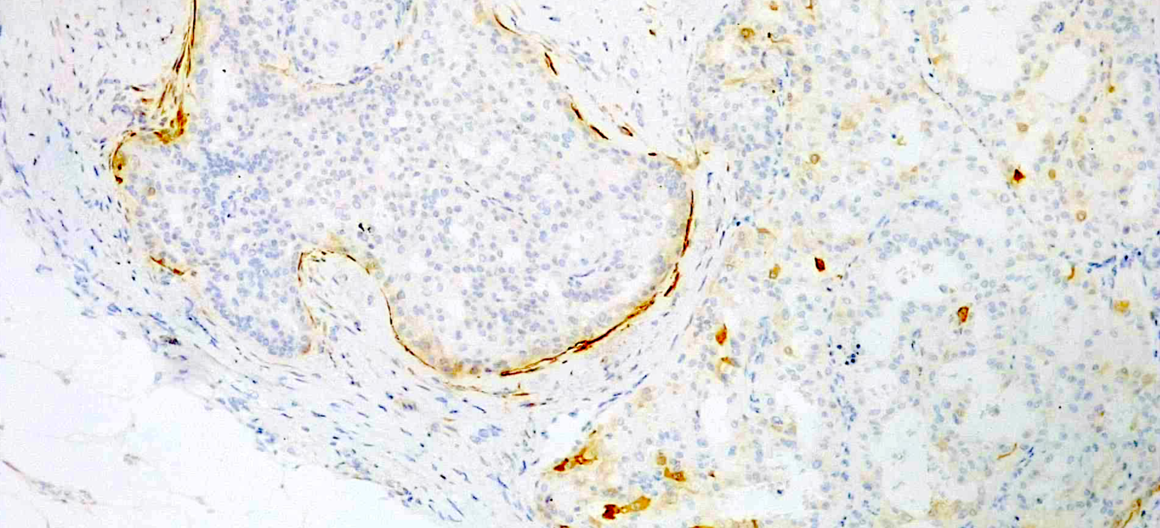
Calponina(CALP)
Slide do autor

Slide 19
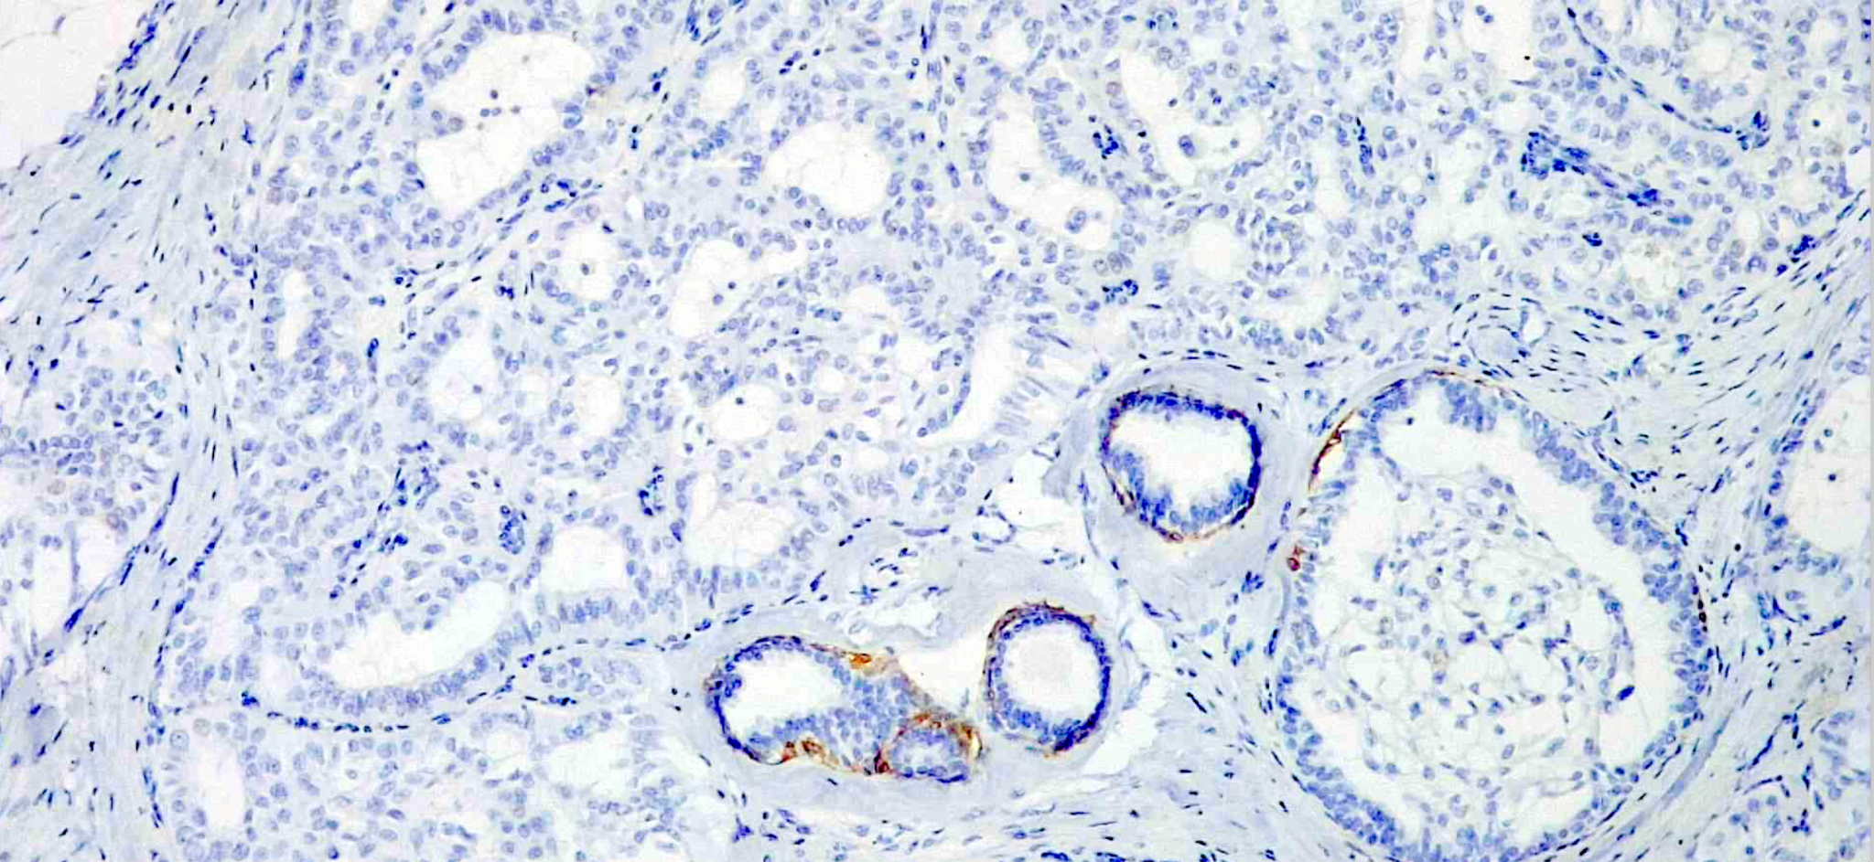
CK14(LL002)
Slide do autor

Slide 20
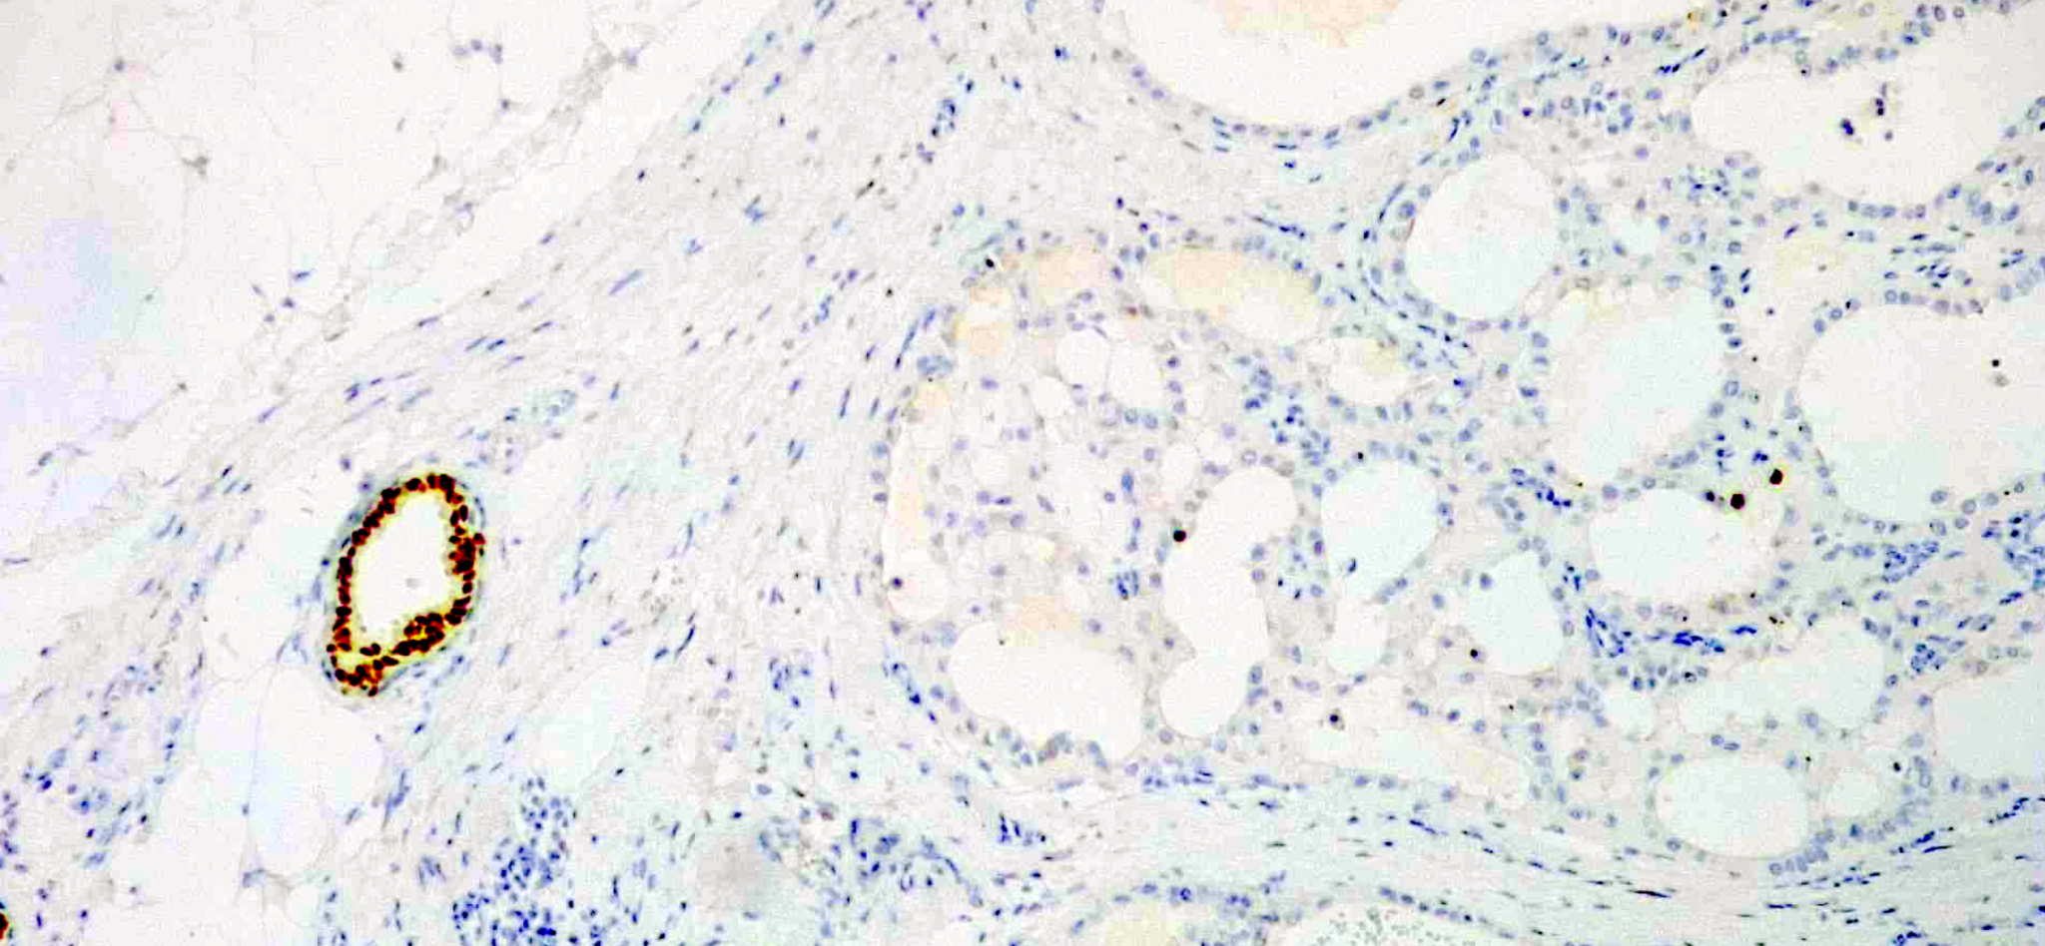
Receptor de estrógeno (EP1)
Slide do autor

Slide 21
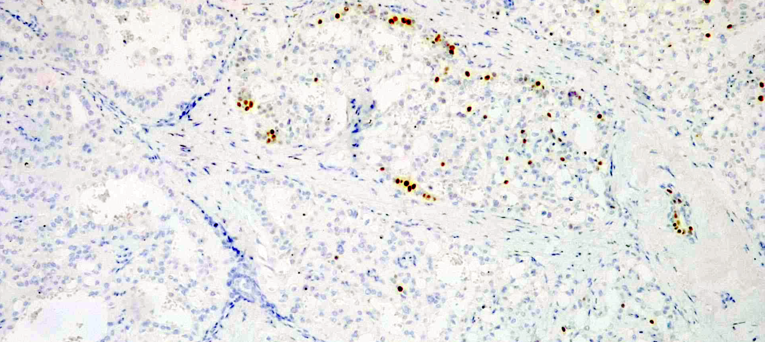
Receptor de estrógeno (EP1)
Slide do autor

Slide 22
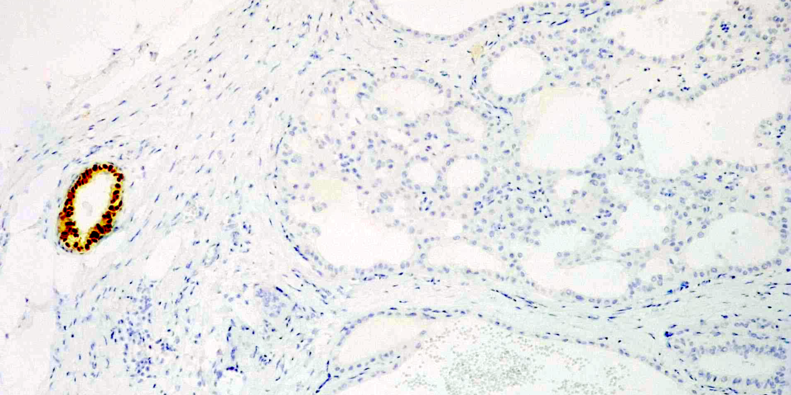
Receptor de progesterona(PgR636)
Slide do autor

Slide 23
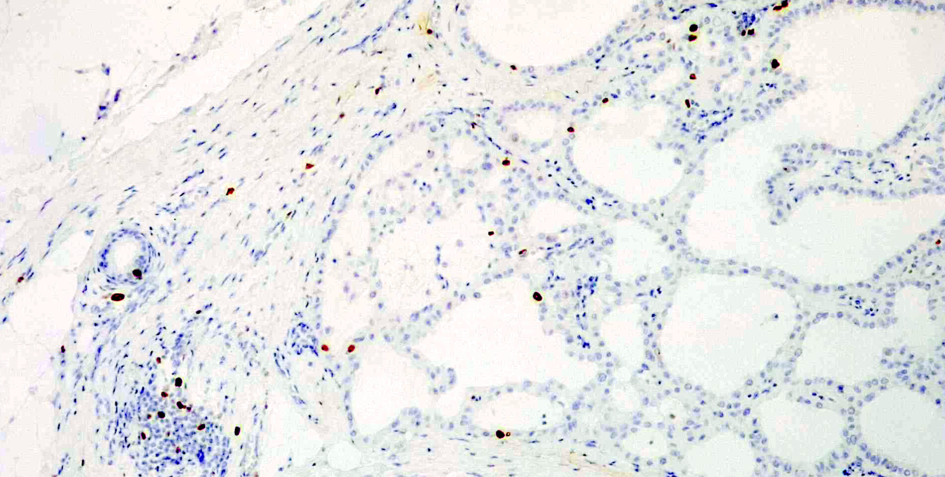
Ki-67(MIB-1)
Slide do autor

Slide 24
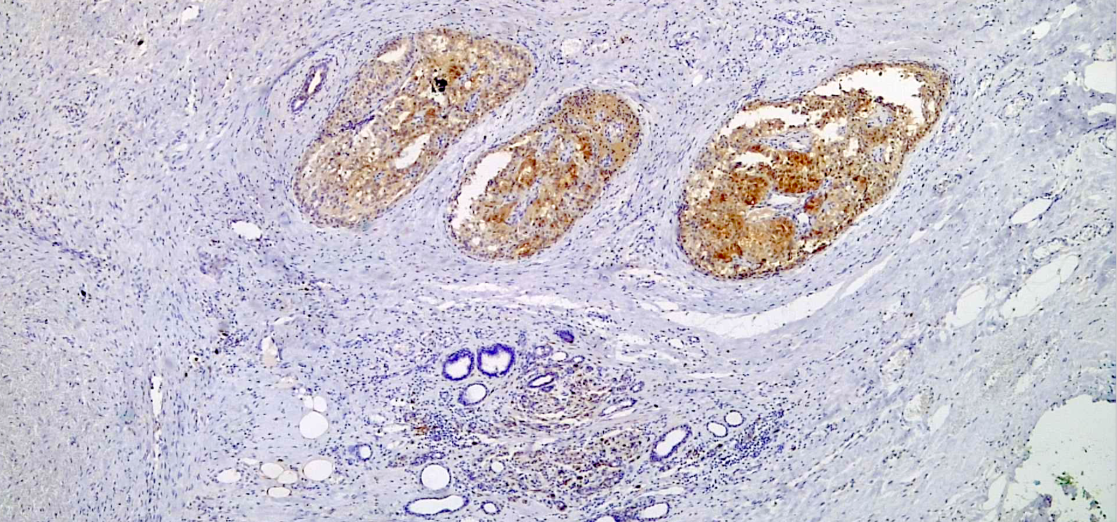
S100 (policlonal)
Slide do autor

Slide 25
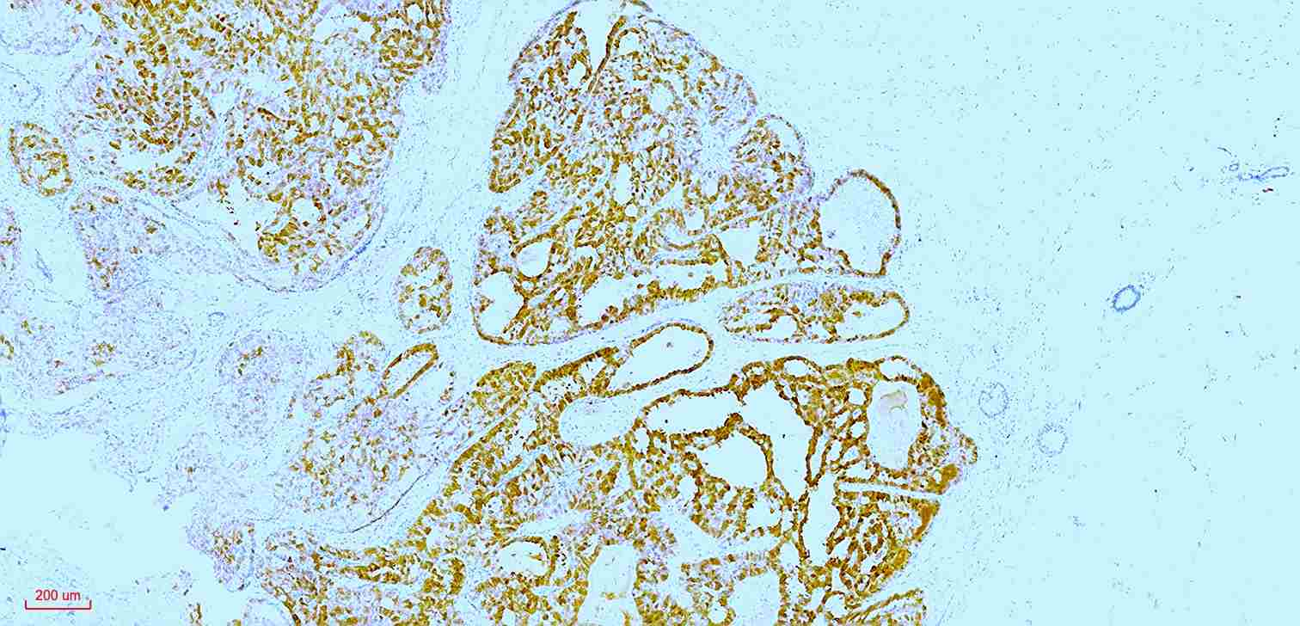
S100 (policlonal)
Slide do autor

Slide 26
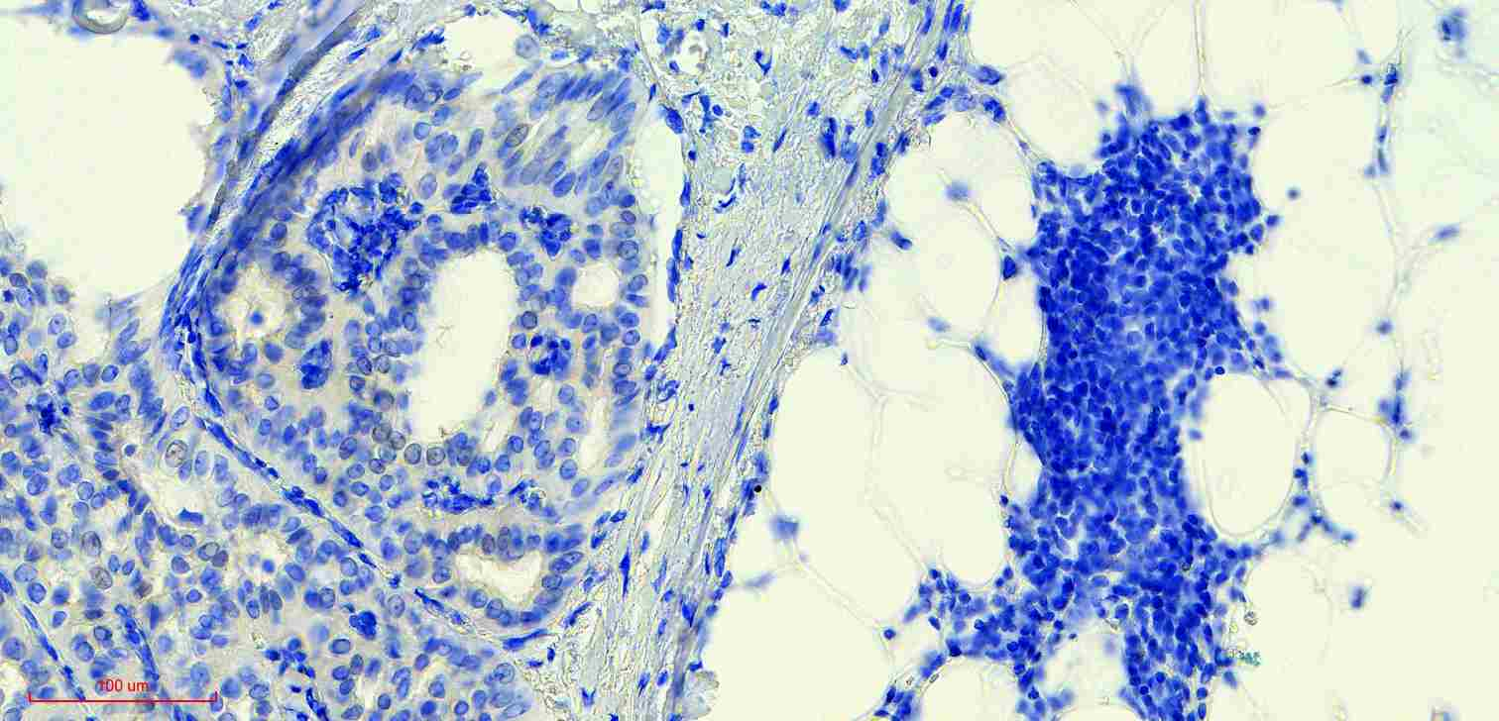
PanTRK(EPR17341-4)
Slide do autor

Slide 27
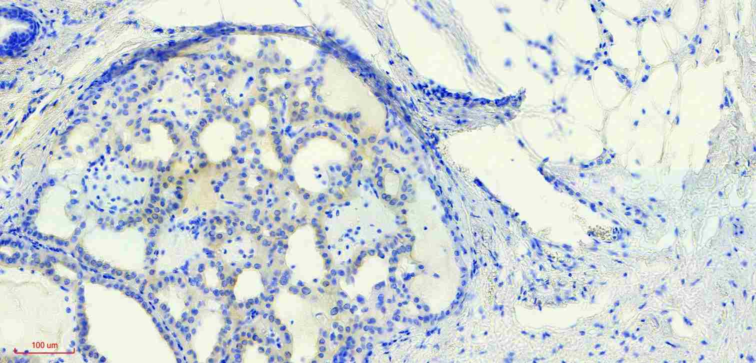
PanTRK(EPR17341-4)
Slide do autor

Slide 28
Mulher, 75 anos
Linfonodo Sentinela Direito - segundo tempo: 00/02 - negativos
Pesquisa de expressão panTRK:
Reação positiva fraca e focal, nuclear e citoplasmática.
Pesquisa de fusão NTRK - NGS (RNA - fusão) - não foram identificadas fusões de nenhum dos genes analisados
(Genes drivers avaliados para presença de fusões gênicas: ABL1, AKT3, ALK, AXL, BRAF, ERG, ETV1, ETV4, ETV5, EGFR, ERBB2, FGFR1, FGFR2, FGFR3, MET, NTRK1, NTRK2, NTRK3, PDGFRA, PPARG, RAF1, RET, ROS1).
QT adj: Carboplatina + Taxol C1: 03/05/21 - C2: 26/05/21
Slide do autor

Slide 29
Mulher, 75 anos
Painel genético (3 tumores primários: CDI em MD, CDIS em ME, Carcinoma seroso de alto grau endométrio);
Tto adjuvante - carcinoma seroso de alto grau de endométrio:
Carbo + Taxol 4-6 ciclos seguido de BQT/Teleterapia
Adjuvância - mama: “CDI” - 7mm TN-like - adjuvância do endométrio suficiente - mama.
Indicação de RT bilateral + HT como quimioprofilaxia do CDIS RH + da ME.
Relatório médico detalhado para oncologista no RJ, onde seguiria o tratamento.
Slide do autor

Slide 30
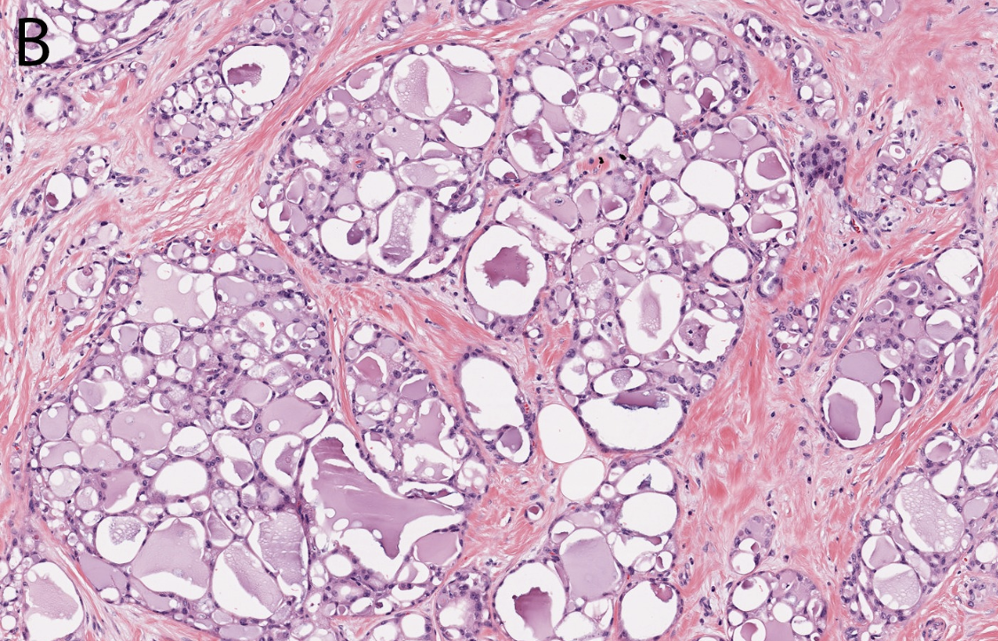
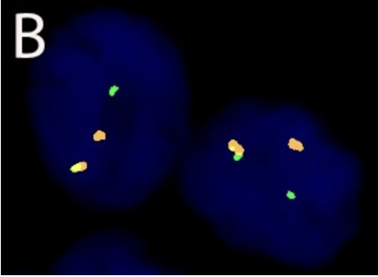
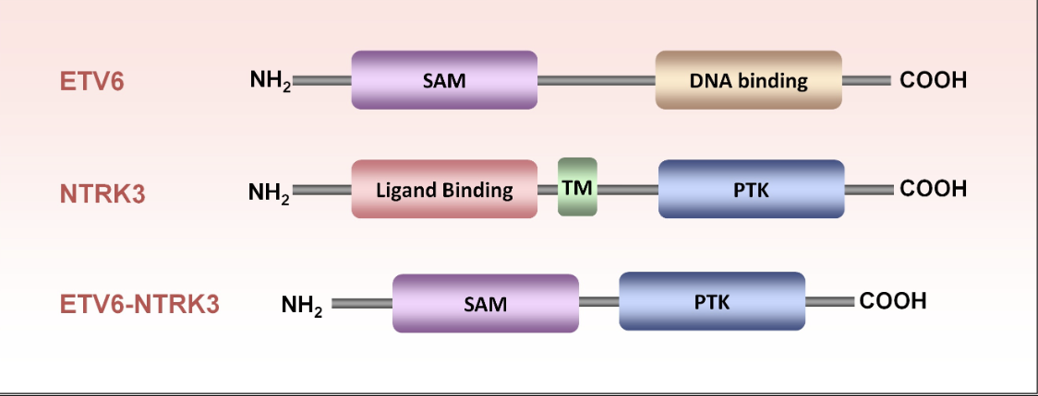
Rare and salivary gland-type tumours: Secretory carcinoma
Intracytoplasmic secretory vacuoles and extracellular eosinophilic, bubbly secretions;
Variable architecture / ETV6-NTRK3 fusion
Frequent in near the nipple or in the upper-outer quadrant
< 0.05% IBC / can happen in men and children
Triple-negative or weakly ER/PR-positive immunoprofile
Indolent clinical course, especially in children and young adults
WHO Classification of Tumours Editorial Board. Breast tumours [Internet]. Lyon (France): International Agency for Research on Cancer; 2019 [cited 2024 May 12th]. (WHO classification of tumours series, 5th ed.; vol. 2). Available from: https://tumourclassification.iarc.who.int/chapters/32.

Slide 31
Fusão ETV6::NTRK3
Target ID | Target Number | Gene A | Gene B | Transcript ID A | Transcript ID B | Exon A | Exon B
T00225 | 1 | ETV6 | NTRK3 | ENST00000396373 | ENST00000394480 | 5 | 15
T00223 | 1 | ETV6 | NTRK3 | ENST00000396373 | ENST00000394480 | 4 | 15
Breakpoint A | Breakpoint B | Supporting Reads | Score | Filter | Fusion Call
chr12:12022903 | chr15:88483984 | 36092 | 863.125827174621 | PASS | Present
chr12:12006495 | chr15:88483984 | 340 | 8.00371073156531 | PASS | Present
Slide do autor

Slide 32
Gene Name | Amplicon ID | Target ID | Transcript | Exons | Off Target | Target Type
AGBL4;NTRK2 | AGBL4.ENST00000371839.5,6;NTRK2.ENST00000376214.16-T00002 | T00002 | ENST00000371839;ENST00000376214 | 5,6;16 | FALSE | Fusion
TPM3;NTRK1 | TPM3.ENST00000368533.7;NTRK1.ENST00000392302.10,11-T00005 | T00005 | ENST00000368533;ENST00000392302 | 7;10,11 | FALSE | Fusion
LMNA;NTRK1 | LMNA.ENST00000368300.2;NTRK1.ENST00000392302.11-T00009 | T00009 | ENST00000368300;ENST00000392302 | 2;11 | FALSE | Fusion
BCAN;NTRK1 | BCAN.ENST00000329117.13;NTRK1.ENST00000392302.11-T00010 | T00010 | ENST00000329117;ENST00000392302 | 13;11 | FALSE | Fusion
NTRK1 | NTRK1.ENST00000392302.2,3,4-T00011 | T00011 | ENST00000392302 | 2,3,2004 | FALSE | Balance5p3p
NTRK1 | NTRK1.ENST00000392302.16,17-T00012 | T00012 | ENST00000392302 | 16,17 | FALSE | Balance5p3p
Slide do autor

Slide 33
NTRK1;DYNC2H1 | NTRK1.ENST00000392302.17;DYNC2H1.ENST00000375735.85-T00014 | T00014 | ENST00000392302;ENST00000375735 | 17;85 | FALSE | Fusion
TPR;NTRK1 | TPR.ENST00000367478.21;NTRK1.ENST00000392302.9-T00015 | T00015 | ENST00000367478;ENST00000392302 | 21;9 | FALSE | Fusion
TPR;NTRK1 | TPR.ENST00000367478.21;NTRK1.ENST00000392302.10,11-T00016 | T00016 | ENST00000367478;ENST00000392302 | 21;10,11 | FALSE | Fusion
TPR;NTRK1 | TPR.ENST00000367478.6;NTRK1.ENST00000392302.12-T00018 | T00018 | ENST00000367478;ENST00000392302 | 6;12 | FALSE | Fusion
TPR;NTRK1 | TPR.ENST00000367478.6;NTRK1.ENST00000392302.12-T00019 | T00019 | ENST00000367478;ENST00000392302 | 6;12 | FALSE | Fusion
NFASC;NTRK1 | NFASC.ENST00000360049.20;NTRK1.ENST00000392302.10,11-T00021 | T00021 | ENST00000360049;ENST00000392302 | 20;10,11 | FALSE | Fusion
Slide do autor

Slide 34
IRF2BP2;NTRK1 | IRF2BP2.ENST00000366609.1;NTRK1.ENST00000392302.10-T00026 | T00026 | ENST00000366609;ENST00000392302 | 1;10 | FALSE | Fusion
TFG;NTRK1 | TFG.ENST00000240851.6;NTRK1.ENST00000392302.10,11-T00076 | T00076 | ENST00000240851;ENST00000392302 | 6;10,11 | FALSE | Fusion
AFAP1;NTRK2 | AFAP1.ENST00000420658.14;NTRK2.ENST00000376214.12,13-T00106 | T00106 | ENST00000420658;ENST00000376214 | 14;12,13 | FALSE | Fusion
SSBP2;NTRK1 | SSBP2.ENST00000320672.11,12;NTRK1.ENST00000392302.12-T00116 | T00116 | ENST00000320672;ENST00000392302 | 11,12;12 | FALSE | Fusion
CD74;NTRK1 | CD74.ENST00000353334.7;NTRK1.ENST00000392302.10,11-T00118 | T00118 | ENST00000353334;ENST00000392302 | 7;10,11 | FALSE | Fusion
SQSTM1;NTRK1 | SQSTM1.ENST00000389805.5;NTRK1.ENST00000392302.10,11-T00124 | T00124 | ENST00000389805;ENST00000392302 | 5;10,11 | FALSE | Fusion
Slide do autor

Slide 35
SQSTM1;NTRK2 | SQSTM1.ENST00000389805.5;NTRK2.ENST00000376214.17-T00125 | T00125 | ENST00000389805;ENST00000376214 | 5;17 | FALSE | Fusion
TRIM24;NTRK2 | TRIM24.ENST00000415680.12;NTRK2.ENST00000376214.15,16-T00156 | T00156 | ENST00000415680;ENST00000376214 | 12;15,16 | FALSE | Fusion
CEL;NTRK1 | CEL.ENST00000372080.7;NTRK1.ENST00000392302.7-T00176 | T00176 | ENST00000372080;ENST00000392302 | 7;7 | FALSE | Fusion
NACC2;NTRK2 | NACC2.ENST00000371753.3,4;NTRK2.ENST00000376214.13-T00177 | T00177 | ENST00000371753;ENST00000376214 | 3,4;13 | FALSE | Fusion
VCL;NTRK2 | VCL.ENST00000211998.16;NTRK2.ENST00000376214.12,13-T00205 | T00205 | ENST00000211998;ENST00000376214 | 16;12,13 | FALSE | Fusion
ETV6;NTRK3 | ETV6.ENST00000396373.4;NTRK3.ENST00000394480.15-T00223 | T00223 | ENST00000396373;ENST00000394480 | 4;15 | FALSE | Fusion
Slide do autor

Slide 36
ETV6;NTRK3 | ETV6.ENST00000396373.4;NTRK3.ENST00000394480.14-T00224 | T00224 | ENST00000396373;ENST00000394480 | 4;14 | FALSE | Fusion
ETV6;NTRK3 | ETV6.ENST00000396373.5;NTRK3.ENST00000394480.15-T00225 | T00225 | ENST00000396373;ENST00000394480 | 5;15 | FALSE | Fusion
ETV6;NTRK3 | ETV6.ENST00000396373.5;NTRK3.ENST00000394480.14-T00226 | T00226 | ENST00000396373;ENST00000394480 | 5;14 | FALSE | Fusion
COX5A;NTRK3 | COX5A.ENST00000322347.1;NTRK3.ENST00000394480.15-T00240 | T00240 | ENST00000322347;ENST00000394480 | 1;15 | FALSE | Fusion
BTBD1;NTRK3 | BTBD1.ENST00000261721.4;NTRK3.ENST00000394480.14-T00241 | T00241 | ENST00000261721;ENST00000394480 | 4;14 | FALSE | Fusion
MPRIP;NTRK1 | MPRIP.ENST00000395811.14;NTRK1.ENST00000524377.12-T00244 | T00244 | ENST00000395811;ENST00000524377 | 14;12 | FALSE | Fusion
Slide do autor

Slide 37
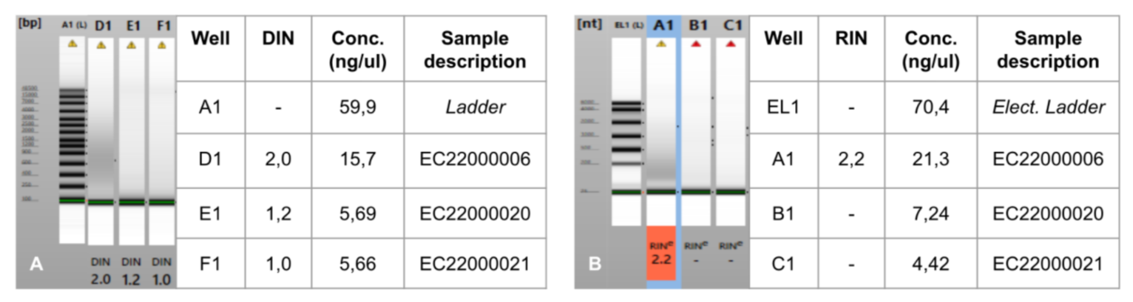
Quantificação e análise de integridade de ácidos nucleicos
Slide do autor

Slide 38
OBRIGADO
thiagodap@hotmail.com

Slide 39
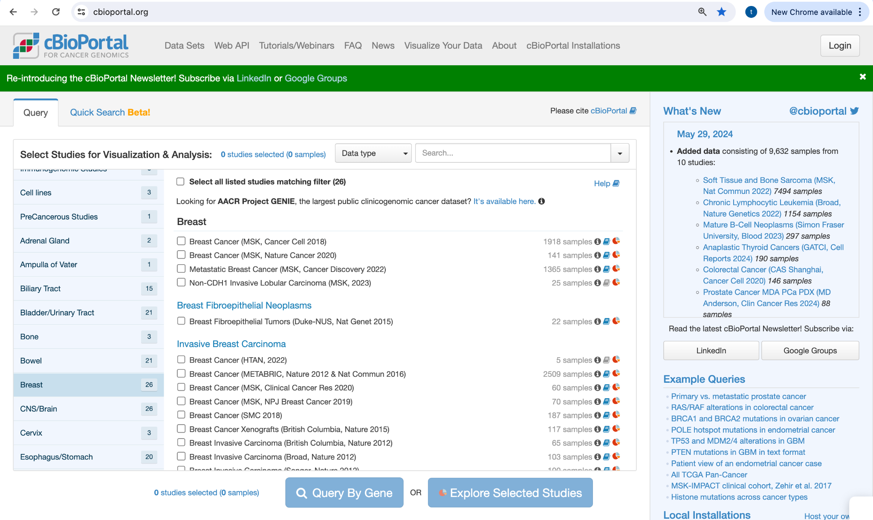
Acesso em 30/05/2024

Slide 40
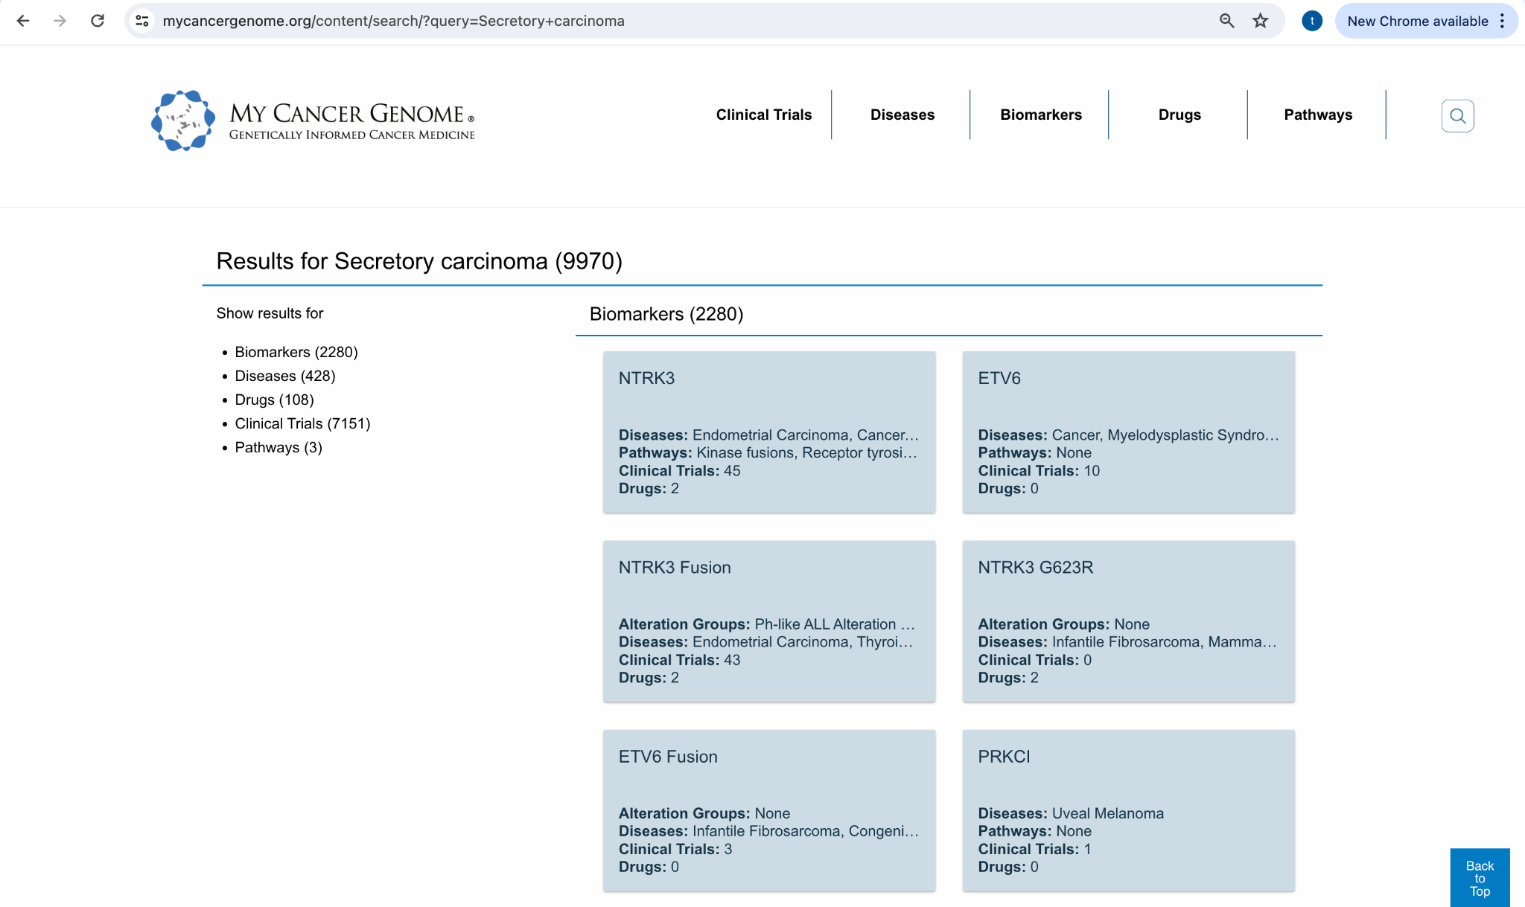
Acesso em 30/05/2024

Slide 41
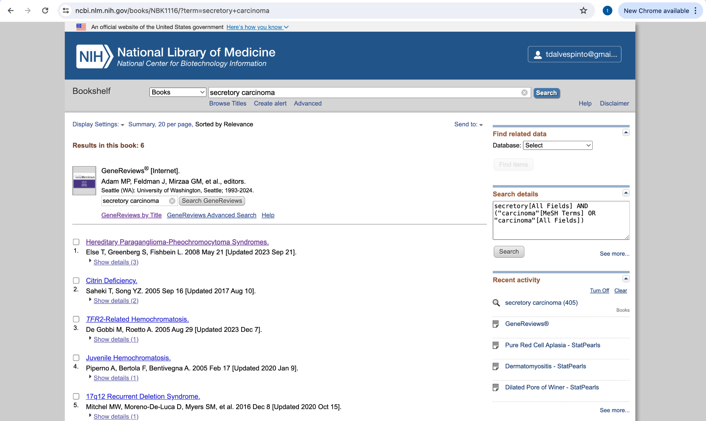
Acesso em 30/05/2024

Slide 42
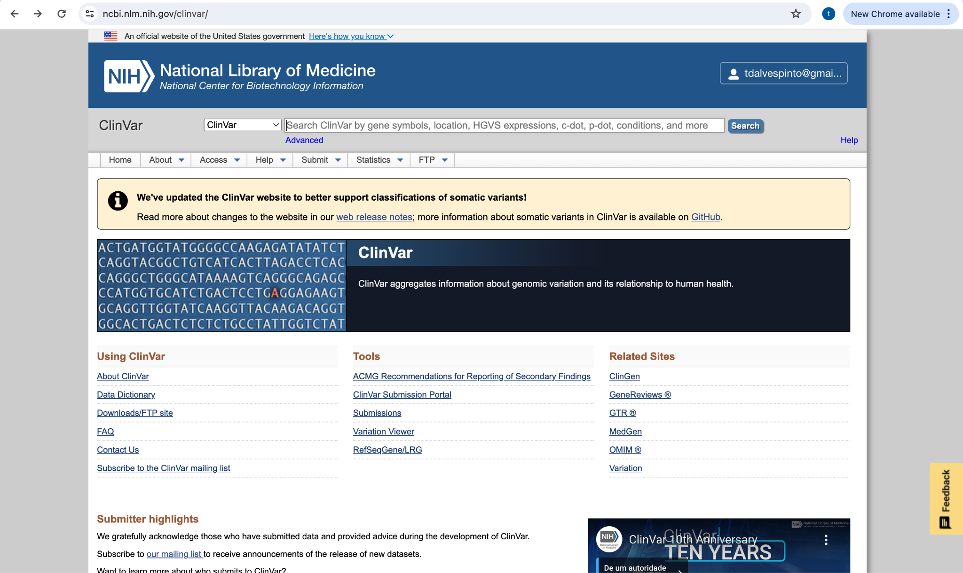
Acesso em 30/05/2024

Slide 43
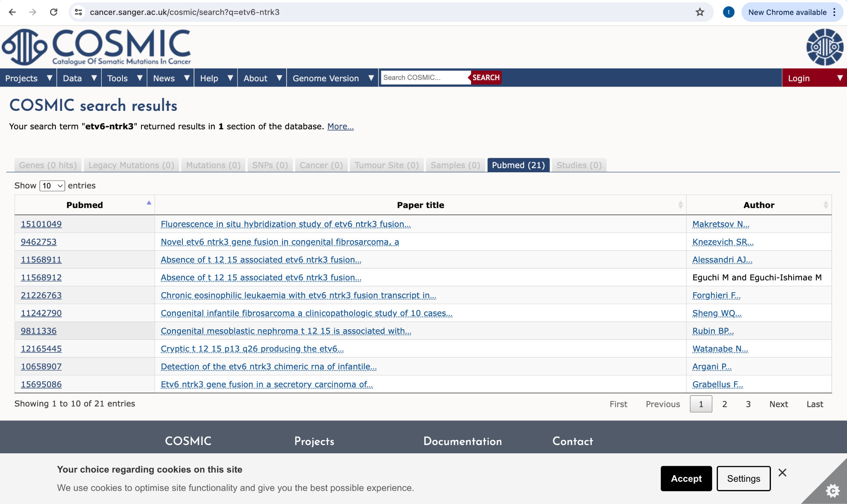
Acesso em 30/05/2024

Slide 44
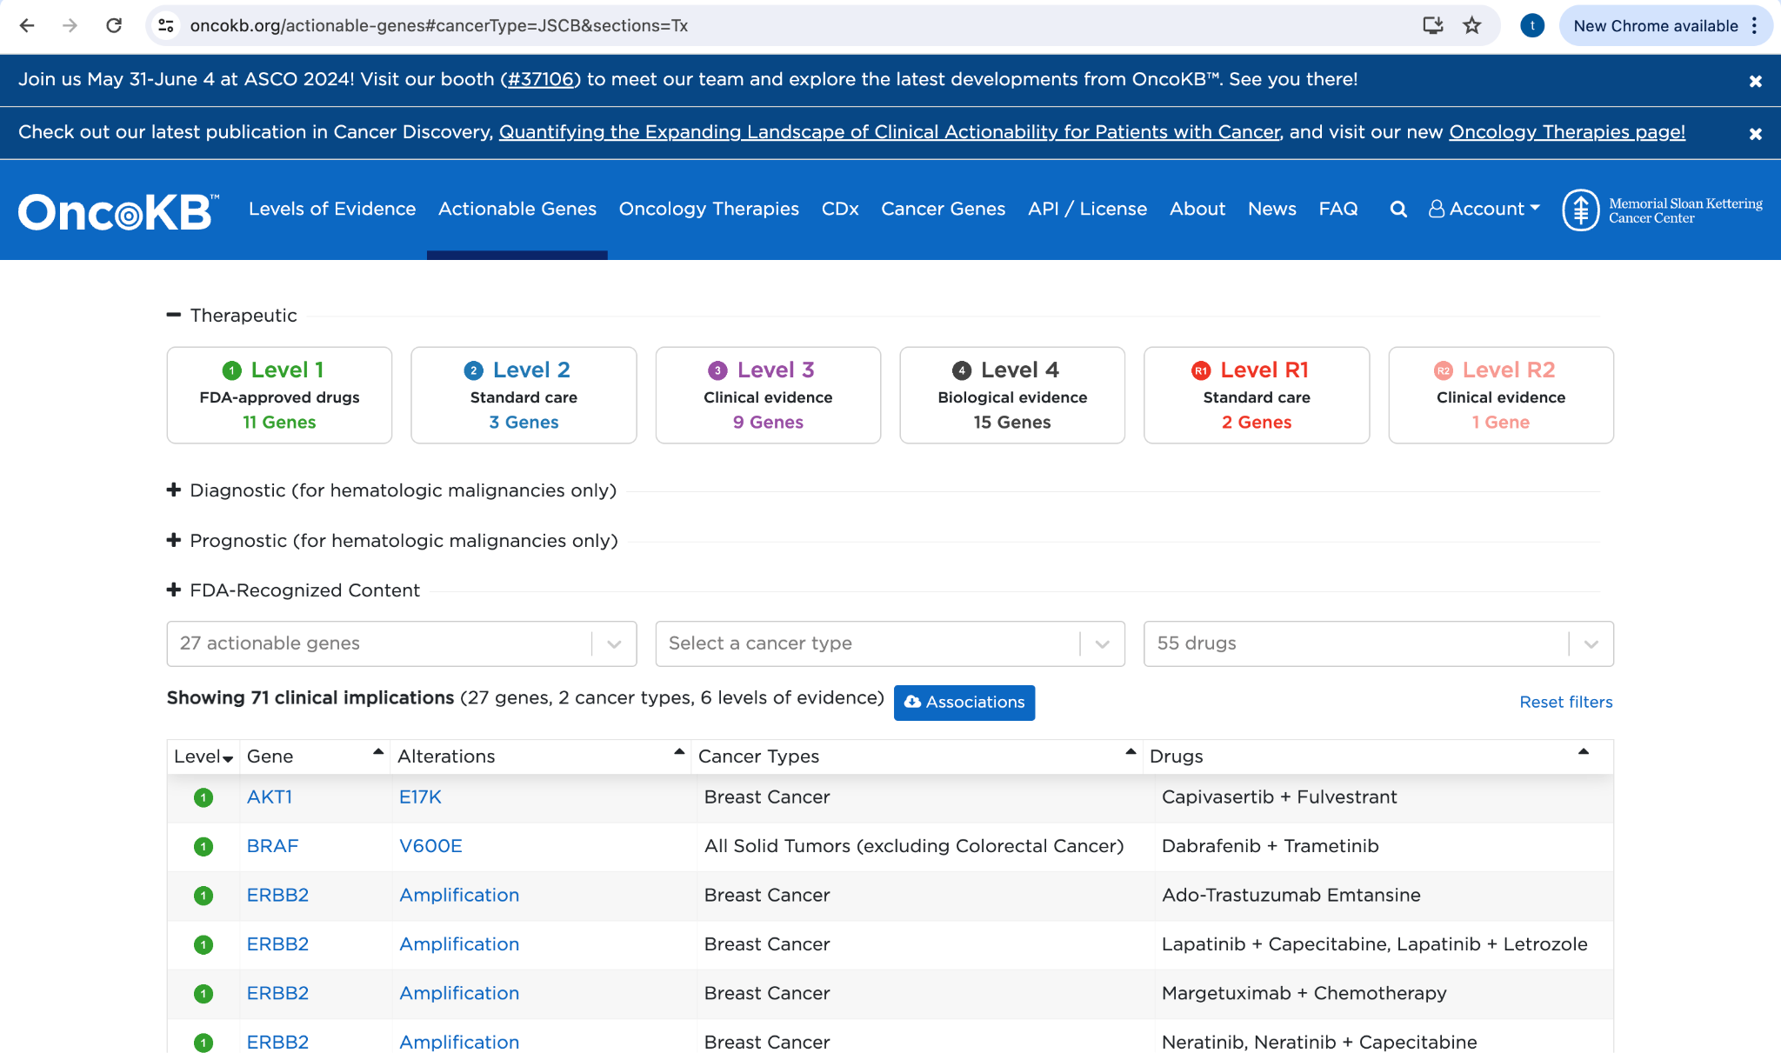
Acesso em 30/05/2024

Slide 45
Definition
Secretory carcinoma is an invasive carcinoma composed of epithelial cells with intracytoplasmic secretory vacuoles and extracellular eosinophilic, bubbly secretions, arranged in a variable architecture and frequently associated with ETV6-NTRK3 fusion.
ICD-O coding
8502/3 Secretory carcinoma
ICD-11 coding
2C60 & XH44J4 Carcinoma of breast, specialized type & Secretory carcinoma of breast
Related terminology
Not recommended: juvenile breast carcinoma { 4285563 }.
Subtype(s)
None
Localization
In women, most secretory carcinomas arise near the nipple or in the upper-outer quadrant, but any region of the breast may be involved, including ectopic breast tissue { 4285563 ; 6445777 ; 11570920 ; 22157932 ; 28548128 }. In men and children, most secretory carcinomas arise in the subareolar region { 4285563 ; 22157932 ; 28548128 }.
Clinical features
Secretory carcinoma typically presents as a slow-growing, firm, painless, mobile mass, sometimes with nipple discharge { 6445777 ; 22157932 }. The radiographical features of a circumscribed lobulated mass may mimic those of benign lesions such as fibroadenoma { 18499854 }.
Epidemiology
Secretory carcinomas account for < 0.05% of all invasive mammary carcinomas and occur predominantly in women { 22494666 ; 7101723 }. Although initially described in children, secretory carcinomas mostly occur in adults, with a mean patient age of 53 years { 22494666 }; most cases present between the fourth and seventh decades of life (range: 3–87 years) { 4285563 ; 6445777 ; 22157932 ; 28548128 ; 26291510 ; 14691916 ; 22832018 ; 19011601 ; 7435774 ; 1992979 }.
Etiology
Unknown

Slide 46
Pathogenesis
Secretory carcinomas are characterized by a t(12;15)(p13;q25) translocation, which results in an ETV6-NTRK3 fusion gene that is present in the in situ and invasive components, indicating that this is an early event in tumorigenesis { 28548128 ; 19011601 ; 12450792 }. Among the breast carcinomas, ETV6-NTRK3 is specific for secretory carcinoma { 15101049 }. ETV6-NTRK3, which was initially identified in congenital fibrosarcoma { 9462753 } and cellular mesoblastic nephroma { 9823307 }, encodes a constitutively activated chimeric tyrosine kinase that signals through the RAS-MAPK and PI3K pathways to drive cellular transformation and oncogenesis { 11751416 }. ETV6-NTRK3 has also been identified in mammary analogue secretory carcinomas arising in other sites, such as the salivary glands, thyroid, and skin { 27631515 ; 27282352 ; 20410810 }. The shared morphological, immunophenotypic, and genetic features of secretory breast carcinomas with analogous tumours at other sites suggest a common pathogenetic origin irrespective of location for these lesions. Notably, ETV6-NTRK3 expression has also been documented in other tumour types, including thyroid papillary carcinoma, leukaemia, glioma, and other carcinomas { 30333516 }. This fusion is therefore unique in being expressed in tumours derived across multiple cell lineages. Other than this alteration, these tumours are relatively quiet genomically, with very low mutation burdens and only occasional chromosomal gains and losses { 28548128 }.
Macroscopic appearance
Secretory carcinomas are typically solitary, firm, circumscribed masses with greyish-white or yellowish-tan cut surfaces. Multifocal tumours have been described { 26291510 ; 14691916 }. The mean tumour size is about 2 cm, but size ranges from 0.5 to 16 cm { 6445777 ; 22157932 ; 28548128 ; 26291510 ; 14691916 ; 22832018 ; 19011601 ; 7435774 ; 2925177 }.
Histopathology
Secretory carcinomas are composed of polygonal tumour cells with eosinophilic granular or vacuolated cytoplasm and round to oval nuclei arranged in microcystic/honeycomb, solid, tubular, or papillary growth patterns. Microcystic areas can simulate thyroid follicles and may merge to form small solid sheets. Most tumours show mixed patterns. Intracytoplasmic and extracellular eosinophilic or amphophilic secretions are consistently present and stain positively with PAS, mucicarmine, and Alcian blue. Nuclear pleomorphism is almost always mild or moderate, and mitotic activity is low. The vast majority of secretory carcinomas are therefore grade 1 or 2 by modified Nottingham grading, with high-grade tumours being exceptionally rare { 26291510 }. The tumour stroma is often sclerotic. An in situ component may be present; it is typically cribriform or solid with low or intermediate nuclear grade { 28548128 ; 14691916 ; 19011601 } and may be identified with the use of myoepithelial antigens.
Immunohistochemically, the tumour cells typically express CEA (polyclonal), S100, mammaglobin, SOX10, and MUC4, often in a strong and diffuse pattern { 22157932 ; 28548128 ; 26291510 ; 19011601 ; 1992979 }. Most tumours express the basal markers CK5/6 and/or EGFR (HER1), although this expression may be focal { 28548128 ; 19011601 }. GATA3, CK8/18, KIT (CD117), and vimentin may also be positive. Most cases are triple-negative for ER, PR, and ERBB2 (HER2), but weak ER/PR expression is not uncommon { 28548128 ; 26291510 ; 19011601 }. The Ki-67 proliferation index is variable but often < 20% { 22157932 ; 26291510 ; 14691916 }.
The differential diagnosis may include carcinoma with apocrine differentiation (usually AR-positive), acinic cell carcinoma { 18462362 }, cystic hypersecretory carcinoma in situ { 24121179 }, and tall cell carcinoma with reversed polarity { 27913435 }, especially in limited biopsy material. Documentation of ETV6-NTRK3 fusion can be used to support the diagnosis of secretory carcinoma, as needed.

Slide 47
Cytology
FNA specimens are typically cellular and composed of cohesive sheets or groups of uniform tumour cells with granular or vacuolated cytoplasm, rounded nuclei with homogeneous chromatin, and few mitoses. Large intracytoplasmic vacuoles with proteinaceous material are characteristic, and similar material may be seen in the background. Signet-ring–like cells may be present { 15584046 ; 2822366 }.
Diagnostic molecular pathology
Secretory carcinoma is characterized by pathognomonic ETV6-NTRK3 gene fusion { 12450792 }. Small molecule inhibitors (larotrectinib and entrectinib) that target NTRK3 and other NTRK family members have recently been developed and have shown promising efficacy in the treatment of patients with TRK fusion cancers { 29466156 ; 29986850 }, including secretory breast carcinoma { 29623306 }. This highlights the need for rapid and reliable molecular confirmation of ETV6-NTRK3, which has routinely been achieved by RT-PCR using ETV6 and NTRK3 primers, including in formalin-fixed, paraffin-embedded tumour blocks { 10895816 }, and by FISH using either ETV6 break-apart probes or 5′ ETV6 and 3′ NTRK3 convergence probes { 15101049 }. The use of a pan-TRK monoclonal antibody for immunohistochemistry identified NTRK (NTRK1, NTRK2, or NTRK3) fusions in 20 of 21 cases in one study { 28719467 } but was less effective in detecting fusions involving NTRK3 in a second study { 30171197 }, indicating that more-reliable NTRK antibodies will be necessary in order for immunohistochemistry to be implemented as a biomarker for NTRK3 inhibitors in secretory breast carcinoma. Next-generation sequencing methods, including hybrid-based capture for multiple specific fusions { 25801821 }, RNA-based panel sequencing for specific expressed transcripts lacking introns { 25384085 }, and methods that integrate RNA sequencing with whole-genome or whole-exome sequencing { 26556708 } are likely to be combined with immunohistochemistry for routine detection of ETV6-NTRK3 for diagnostic and therapeutic assignment.
Essential and desirable diagnostic criteria
Essential: characteristic morphological and immunophenotypic features as described, especially including intracytoplasmic and extracellular secretions and an either triple-negative or weakly ER/PR-positive immunoprofile.
Desirable: can be confirmed by FISH showing ETV6 rearrangement or identification of ETV6-NTRK3 by next-generation sequencing.
Staging
Secretory carcinoma is staged according to the guidelines for invasive carcinomas of the breast. Most secretory carcinomas present as pT1 or pT2 tumours. Axillary metastases are reported in about 20–35% and typically involve no more than three nodes { 6445777 ; 22157932 ; 28548128 ; 22494666 ; 26291510 }. Distant metastases are very rare { 6445777 ; 26291510 ; 2925177 ; 15963235 ; 11106125 }.
Prognosis and prediction
Secretory carcinomas generally have an indolent clinical course, especially in children and young adults, and even in patients with axillary nodal metastases { 4285563 ; 6445777 ; 22494666 ; 19011601 }. Some tumours in older adults may be more aggressive and manifest with late recurrences { 2925177 }. Only rare deaths have been reported { 6445777 ; 26291510 ; 2925177 ; 15963235 }. In a population-based study, the 5-year and 10-year cause-specific survival rates were 94% and 91%, respectively { 22494666 }.

